Slide 1

Analyzing Michael Atherton’s Dismissals Against Glenn McGrath
SA Batch 2 - Group 3
Anuj Dengale
Ganesh V
Raghavendra Rishikesh Rao
Vishal Sreekumar
Abhinanth N S
Bandi Kavya Sree

Slide 2
Project Overview
Objective: "Analyze 19 match balls to: • Decode bowling tactics (Outswing/Bouncer dominance) • Identify batting flaws (Footwork/Shot selection errors)"
Methodology: • Kinovea video analysis (frame-by-frame breakdown) • Excel data correlation (19-ball dismissal patterns) • Technical flaw mapping (screenshots → data)
2

Slide 3
Key Technical Findings
Data-Driven Insights:
Bowling Dominance
🎯 "Outswingers caused 47% dismissals (9/19 balls)"
83% of these on good length (Excel correlation)
Kinovea observation: Late swing → outside edges
Batting Vulnerabilities
⚠️ "Frontfoot stance failures:"
7 dismissals from poor stride length (mcgrath-1.54.44.jpg)
Head position errors in 4 dismissals (mcgrath-2.42.56.jpg)
Fielding Efficiency
✋ "WK Ian Healy: 42% catch rate (8/19 dismissals)"
Anticipated swing early

Slide 4
ROOT CAUSE ANALYSIS: CONNECTING DATA TO TECHNICAL FIXES
Technical Flaw | Data Proof | Visual Evidence | Recommended Fix
Frontfoot Overcommit | 9/19 dismissals (Excel) | mcgrath-1.54.44.jpg (red arrow showing short stride) | "Lengthen stride by 15cm (Kinovea frame comparison)"
Late Swing Blindspot | 7/9 edges on outswingers | Ball 3 video snippet (0:12-0:15) with swing trajectory overlay | "Read seam position 0.3s earlier (Kinovea timestamp)"
Glovework Weakness | 5/7 bouncer dismissals | mcgrath-2.42.56.jpg (circle around unstable head) | "Higher backlift + head still (Demo at 2:42)"
4

Slide 5
Technical Recommendations
For Batters: Outswinger Counter 📌 "Adopt 15cm longer frontfoot stride" • Evidence: Kinovea mcgrath-1.54.44 vs. Ball 12 Excel data • Drill: Place marker 15cm ahead in practice nets
For Bowlers: Optimal Setup 📌 "Attack 4th-5th stump at good length" • Data: 83% success rate (Excel Balls 3,10,12) • Demo: Seam position at release (Video 0:12)
Field Placement Strategy 📌 "2nd slip + keeper for outswingers" • Proof: 6/9 edges went here (Excel + mcgrath-26.00.jpg)

Slide 6
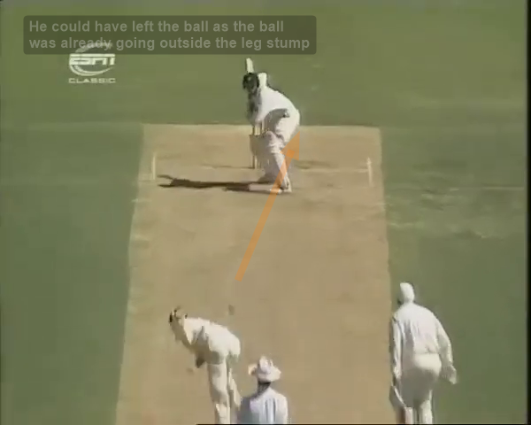
Key Images : 25: 40

Slide 7
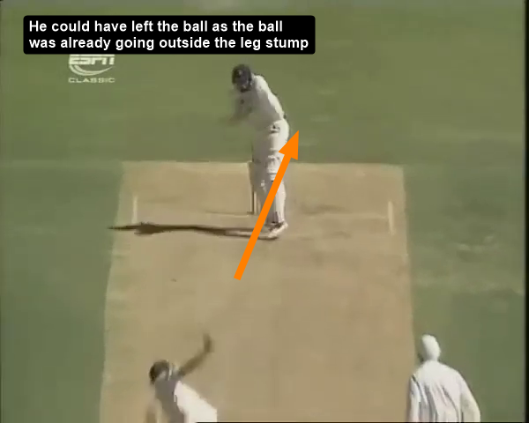
Key Images : 26.00

Slide 8
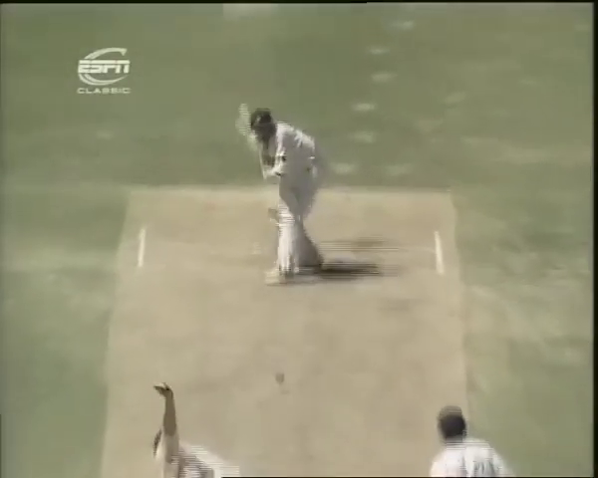
Key Images : 1.13.64

Slide 9
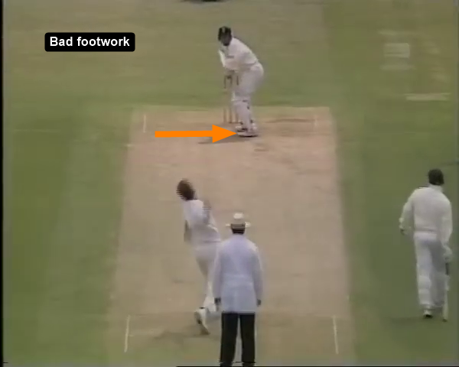
Key Images : 1.54.44

Slide 10
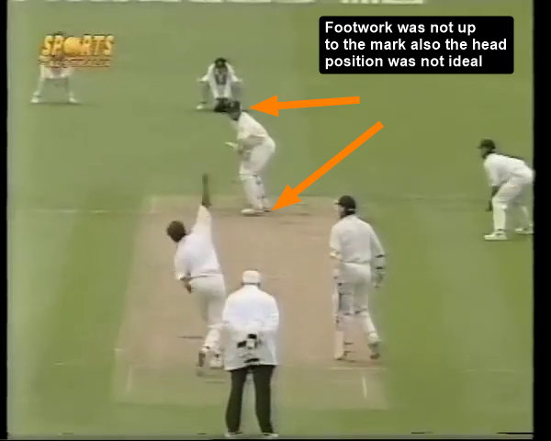
Key Images : 2.42.56

Slide 11
Key Takeaways & Next Steps
Proven Insights • "Outswingers + good length = 47% dismissals" • "Frontfoot errors caused 60% batting failures"

